Slide 1
CompTIA Security+ Guide to Network Security Fundamentals, Sixth Edition
Chapter 10
Mobile and Embedded Device Security

Slide 2
Objectives
10.1 List and compare the different types of mobile devices
10.2 Explain the risks associated with mobile devices
10.3 List ways to secure a mobile device
10.4 Describe different types of embedded systems and IoT devices and how to secure them

Slide 3
Types of Mobile Devices
Core features | Additional features
Small form factor | Global Positioning System (G P S)
Mobile operating system | Microphone and/or digital camera
Wireless data network interface for accessing the Internet, such as Wi-Fi or cellular telephony | Wireless cellular connection for voice communications
Applications (apps) that can be acquired through different means | Wireless personal area network interfaces like Bluetooth or near field communication (N F C)
Local non removable data storage | Removable storage media
Data synchronization capabilities with a separate computer or remote servers | Support for using the device itself as removable storage for another computing device

Slide 4
Tablets (1 of 2)
Tablets
Portable computing devices generally larger than smartphones and smaller than notebooks
Often classified by their screen size
Generally lack a built-in keyboard
Rely on a touch screen
Primarily a display device with limited user input
Most popular O Ss for tablets are Apple i O S, Google Android, and Microsoft Windows

Slide 5
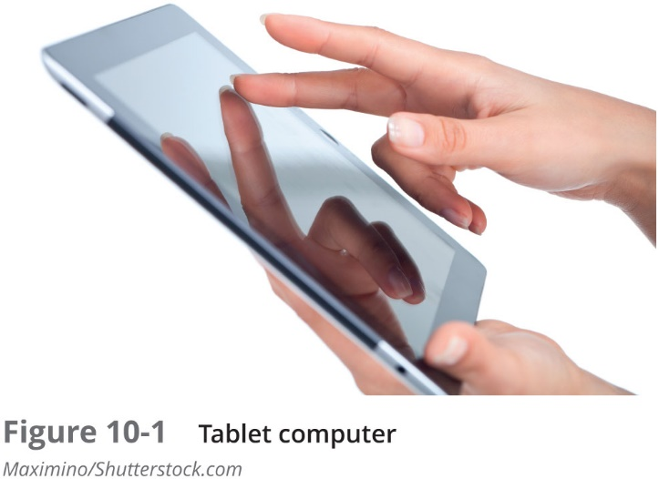
Tablets (2 of 2)

Slide 6
Smartphones
Smartphone
Has all the tools that a feature phone has but also includes an O S that allows it to run apps and access the Internet
A feature phone is a traditional cellular phone with limited features, such as camera, M P 3 music player, and the ability to send and receive short message service (S M S) text messages
Considered handheld personal computers
Because of their ability to run apps

Slide 7
Wearable Technology (1 of 2)
Wearable technology
Devices that can be worn by the user instead of carried
Examples of wearable technology:
Fitness trackers
Smart watch
Can serve as an accessory to a smartphone to view messages

Slide 8
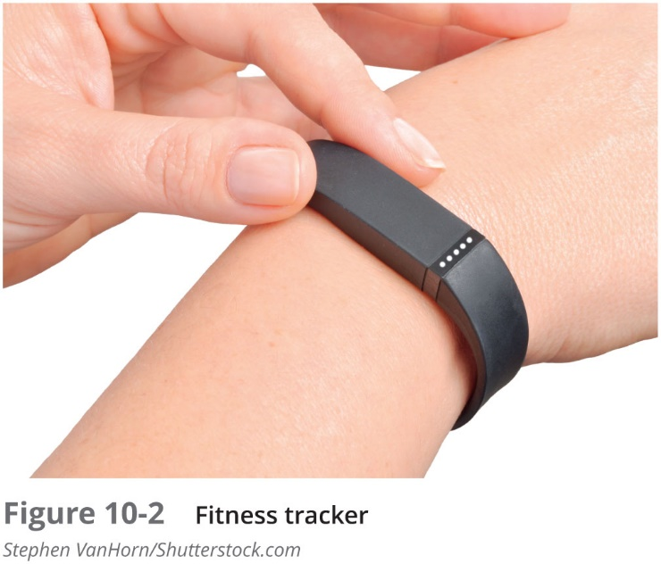
Wearable Technology (2 of 2)

Slide 9
Portable Computers (1 of 4)
Portable computers
Have similar hardware and run the same O S and application software found on a desktop computer
Primary difference
Portable computers are smaller self-contained devices that can easily be transported from one location to another while operating on battery power
Laptop
Regarded as the earliest portable computer
Have multiple hardware ports and may accommodate limited hardware upgrades

Slide 10
Portable Computers (2 of 4)
Notebook computers
A smaller version of a laptop computer
Typically weigh less than laptops and are small enough to fit inside a briefcase
Designed to include only basic, frequently used features
Subnotebook computer
Even smaller than standard notebooks
Use low-powered processors and solid state drives (S S Ds)
Have both touch screen and a physical keyboard

Slide 11
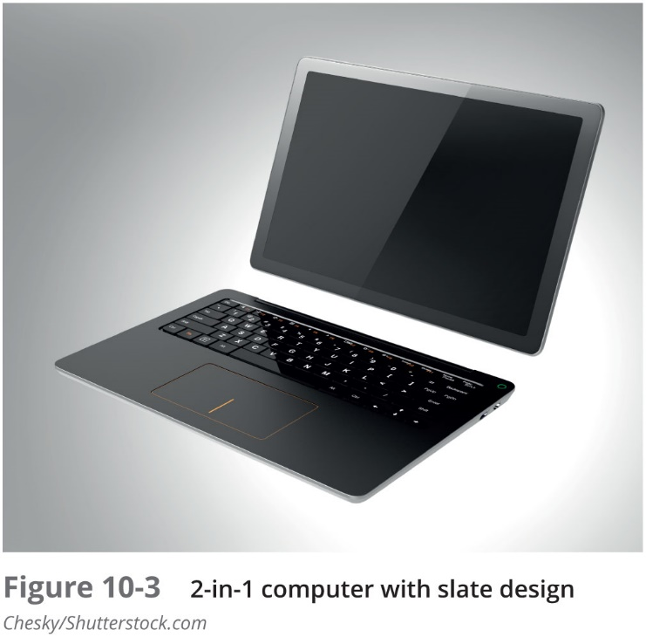
Portable Computers (3 of 4)

Slide 12
Portable Computers (4 of 4)
Web-based computer
Contains a limited version of the Linux O S and a web browser
Has an integrated media player
Designed to be used while connected to the Internet
No traditional applications can be installed
No user files are stored locally
Accesses web apps and saves user files on the Internet

Slide 13
Mobile Device Connectivity Methods
Many mobile devices use Wi-Fi as the standard connectivity method
Many devices support other types of connectivity methods:
Cellular
Satellite
Infrared
A N T – a proprietary wireless network technology used primarily by sensors for communicating data
U S B connections

Slide 14
Enterprise Deployment Models (1 of 2)
Model name | Description | Employee actions | Business actions
Bring your own device (B Y O D) | Allows users to use their own personal mobile devices for business purposes | Employees have full responsibility for choosing and supporting the device | This model is popular with smaller companies or those with temporary staff
Corporate owned, personally enabled (C O P E) | Employees choose from a selection of company approved devices | Employees are supplied the device chosen and paid for by the company | Company decides level of choice and freedom for employees
Choose your own device (C Y O D) | Employees choose from a limited selection of approved devices but the employee pays the upfront cost of the device while business own contract | Employees are offered a suite of choices that the company has approved for security, reliability, and durability | Company often provides a stipend to pay monthly fees to wireless carrier
Virtual desktop infrastructure (V D I) | Stores sensitive applications and data on a remote server that is accessed through a smartphone | Users can customize the display of data as if the data were residing on their own device | Enterprise can centrally protect and manage apps and data on server instead of distributing to smartphones
Corporate-owned | Device is purchased and owned by the enterprise | Employees use the phone only for company-related business | Enterprise is responsible for all aspects of the device

Slide 15
Enterprise Deployment Models (2 of 2)
Benefits of the B Y O D, C O P E, and C Y O D models:
Management flexibility
Less oversight
Cost savings
Increased employee performance
Simplified I T infrastructure
User benefits:
Choice of device
Choice of carrier
Convenience

Slide 16
Mobile Device Risks
Security risks of mobile devices:
Mobile device vulnerabilities
Connection vulnerabilities
Accessing untrusted content
Deployment model risks

Slide 17
Physical Security
About 68 percent of all healthcare security breaches were the result of the loss or theft of a mobile device
One-quarter of all laptop thefts occurred from unattended cars
Or while traveling on airplanes and trains
15 percent occurred in airports and hotels
12 percent stolen from restaurants
Users must guard against shoulder surfing
Strangers who want to view sensitive information

Slide 18
Limited Firmware Updates
Apple i O S is a closed and proprietary architecture
Users update through i Tunes or through the over-the-air (O T A) update (called firmware O T A updates)
Google does not create the hardware that Android runs on
It is very difficult to distribute security updates to the devices through the wireless carriers
Many O E Ms had modified Android and were reluctant to distribute updates that might conflict with their changes
Wireless carriers needed to perform extensive testing
O E Ms and wireless carriers are hesitant to distribute Google updates
No financial incentive to update mobile devices

Slide 19
Location Tracking
Mobile devices with global positioning system (G P S) capabilities support geolocation
The process of identifying the geographical location of the device
Mobile devices using location services are at an increased risk of targeted physical attacks
Attackers can determine where users are and plan to steal the mobile device or inflict harm
G P S tagging
Adding geographical identification data to media
Also called geo-tagging

Slide 20
Unauthorized Recording
Basic precautions against unauthorized recording:
Do not use a webcam in any room where private activities take place
Place a piece of electrical tape over the lens of a webcam when not in use
Only allow permission to access the camera or microphone for apps that require that use
Periodically review app permissions on the device and turn off those permissions that are not necessary

Slide 21
Connection Vulnerabilities
Name | Description | Vulnerability
Tethering | A mobile device with an active Internet connection can be used to share that connection with other mobile devices through Bluetooth or Wi-Fi | An unsecured mobile device may infect other tethered mobile devices or the corporate network
USB On-the-Go (O T G) | A mobile device with a U S B connection can act as either a host or a peripheral used for external media access | Connecting a mobile device as a peripheral to an infected computer could allow malware to be sent to the device
Connecting to public networks | Mobile devices must at time use public external networks for Internet access | Because these networks are beyond the control of the organization, attackers can eavesdrop on the data transmissions and view sensitive information

Slide 22
Accessing Untrusted Content (1 of 3)
Quick Response (Q R) codes
A matrix or two-dimensional barcode which can be read by an imaging device
Applications for these codes include:
Product tracking, item identification, time tracking, document management, and general marketing
An attacker can create an advertisement listing a reputable website but include a Q R code that contains a malicious U R L
Code directs a user’s browser to the attacker’s imposter website or to a site that downloads malware
Users can circumvent built-in limitations on smartphones to download from an unofficial third-party app store (called sideloading)
Called jailbreaking on Apple i O S devices and rooting on Android devices

Slide 23
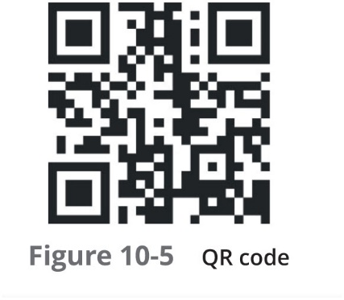
Accessing Untrusted Content (2 of 3)

Slide 24
Accessing Untrusted Content (3 of 3)
Short message service (S M S)
Text messages of a maximum of 160 characters
Multimedia messaging service (M M S)
Provides for pictures, video, or audio to be included in text messages
Threat actors can send S M S messages that contain links to untrusted content
Or send a specially crafted M M S video that can introduce malware into the device

Slide 25
Deployment Model Risks
Risks associated with enterprise deployment models:
Users may erase the installed built-in limitations on their mobile device, which disables the built-in security features
Personal mobile devices are often shared among family members and friends, subjecting sensitive corporate data installed on a user’s device to outsiders
Different mobile devices have different hardware and O Ss that technical support staff might have to support
It might be difficult securing the personal smartphone from an employee who left the company

Slide 26
Securing Mobile Devices
Steps to securing mobile devices:
Configuring the device
Using mobile management tools
Configuring device app security

Slide 27
Device Configuration (1 of 3)
Disable Unused Features
It is important to disable unused features and turn off those that do not support the business use of the phone
Should disable Bluetooth wireless data communication
In order to prevent bluejacking and bluesnarfing
Use Strong Authentication
Restrict unauthorized users with a screen lock and require a strong passcode
Screen Lock
Lock screen prevents device from being used until the user enters the correct passcode
Set screen to lock after a period of inactivity

Slide 28
Device Configuration (2 of 3)
Screen Lock (continued)
After a specific number of failed attempts to enter a passcode, additional security protections will occur:
Extend lockout period
Reset to factory settings
Context-aware authentication
The device automatically unlocks and stays unlocked until a specific action occurs
Passcode
Use a personal identification number (PIN)
Use a fingerprint “swipe” on a sensor to unlock the device
Draw or swipe a specific pattern connecting dots to unlock the device

Slide 29
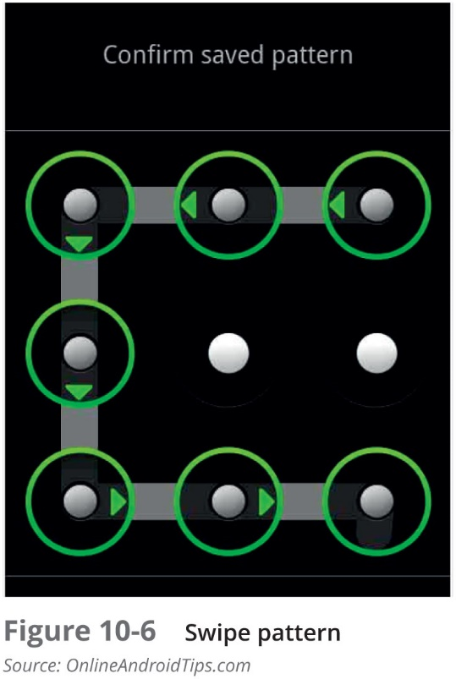
Device Configuration (3 of 3)

Slide 30
Manage Encryption
Significant loopholes in which mobile device data can be accessed through data-in-transit and remote data-at-rest
Data-in-transit
Carriers build surveillance capabilities into their networks
Allows law enforcement agencies to collect data-in-transit
New mobile apps deliver over-the-top (O T T) content
Delivery of content over the Internet without telecoms being directly involved
Remote Data-at-Rest
Apple and Google possess decryption keys necessary to unlock data on their servers
Courts routinely server order to Apple and Google to provide data stored on their servers
Users can choose to turn off backups to i Cloud or Google servers

Slide 31
Segment Storage
Storage segmentation
Separating business data from personal data
Containerization
Separating storage into separate business and personal “containers” and managing each appropriately
Advantages to storage segmentation:
Helps companies avoid data ownership privacy issues and legal concerns regarding a user’s personal data
Allows companies to delete only business data when necessary without touching personal data

Slide 32
Enable Loss or Theft Services (1 of 2)
To reduce the risk of theft or loss:
Keep the mobile device out of sight when traveling in a high-risk area
Always maintain awareness of your surroundings
When holding the device, use both hands to make it difficult for a thief to snatch
Do not use the device on escalators or near train doors
White or red headphone cords may indicate they are connected to an expensive device, so consider replacing cord
If theft does occur, do not resist or chase the thief
If a device is lost or stolen, several security features can be enabled to locate the device or limit the damage (see Table on the next slide)
If a device is lost or stolen and cannot be located, it may be necessary to perform a remote wiping, which erases sensitive data stored on the device

Slide 33
Enable Loss or Theft Services (2 of 2)
Security feature | Explanation
Alarm | The device can generate an alarm even if it is on mute
Last known location | If the battery is charged to less than a specific percentage, the device’s last known location can be indicated on an online map
Locate | The current location of the device can be pinpointed on a map through the device’s G P S
Remote lookout | The mobile device can be remotely locked and a custom message sent that is displayed on the login screen
Thief picture | A thief who enters an incorrect passcode three times will have her picture taken through the device’s on-board camera and emailed to the owner

Slide 34
Mobile Management Tools
Support tools:
Mobile device management
Mobile application management
Mobile content management

Slide 35
Mobile Device Management (M D M) (1 of 2)
Mobile Device Management (M D M)
Tools that allow a device to be managed remotely by an organization
Usually involve:
A server component that sends out management commands to mobile devices
A client component to receive and implement the management commands
An administrator can perform over the air (O T A) updates or configuration changes to one device

Slide 36
Mobile Device Management (M D M) (2 of 2)
Some features that M D M tools provide:
Rapidly enroll new mobile devices (on-boarding) and quickly remove devices (off-boarding)
Apply or modify default device settings
Enforce encryption settings, antivirus updates, and patch management
Display an acceptable use policy that requires consent before allowing access
Configure email, calendar, contacts, Wi-Fi, and V P N profiles O T A
Discover devices accessing enterprise systems
Approve or quarantine new mobile devices
Distribute and manage public and corporate apps
Securely share and update documents and corporate policies
Detect and restrict jailbroken and rooted devices
Selectively erase corporate data
Send S M S text messages to selected users or groups of users

Slide 37
Mobile Application Management (M A M)
Mobile Application Management (M A M)
Tools and services responsible for distributing and controlling access to apps
Initially controlled apps through app wrapping
Sets up a “dynamic” library of software routines and adds to an existing program to restrict parts of an app
Using a M A M originally required the use of an M D M as well
Newer versions of mobile O Ss have M A M incorporated into the software itself

Slide 38
Mobile Content Management (M C M)
Content management
Used to support the creation and editing/modification of digital content by multiple employees
A mobile content management (M C M) system
Is tuned to provide content management to hundreds or even thousands of mobile devices used by employees in an enterprise

Slide 39
Mobile Device App Security
Apps on the device should be secured also
Apps can require that the user provide authentication (such as a passcode) before access is granted
M D Ms can support:
Application whitelisting - ensures that only preapproved apps can run on the device
Geo-fencing - uses the device’s G P S to define geographical boundaries where the app can be used

Slide 40
Embedded Systems and the Internet of Things
A growing trend is to add capabilities to devices that have never had computing power before
These devices include:
Embedded systems and the Internet of Things

Slide 41
Embedded Systems (1 of 4)
Embedded system
A computer hardware and software contained within a larger system designed for a specific function
Examples of embedded systems:
Medical devices
Aircraft
Vehicles
Industrial machines
Heating, ventilation, and air conditioning (H V A C) environmental systems

Slide 42
Embedded Systems (2 of 4)
Industrial control systems (I C S) - control locally or at remote locations by collecting, monitoring, and processing real-time data so that machines can directly control devices such as:
Valves
Pumps
Motors
Multiple I C S are managed by a larger supervisory control and data acquisition (S C A D A) system

Slide 43
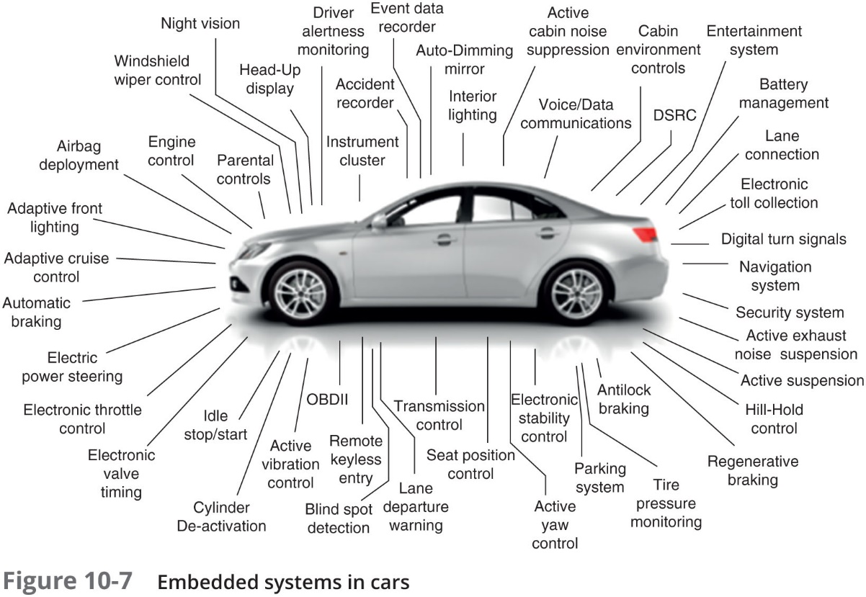
Embedded Systems (3 of 4)

Slide 44
Embedded Systems (4 of 4)
System on a chip (S o C)
All the necessary hardware components contained on a single microprocessor chip
Real-time operating system (R T O S)
Software designed for an S o C in an embedded system
Embedded system receive very large amounts of data quickly
R T O S is tuned to accommodate very high volumes of data that must be immediately processed for critical decision making

Slide 45
Internet of Things (1 of 3)
Internet of Things (I o T)
Connecting any device to the Internet for the purpose of sending and receiving data to be acted upon
Includes:
Wearable technology and multifunctional devices
Also includes everyday home automation items such as:
Thermostats, coffee makers, tire sensors, slow cookers, keyless entry systems, washing machines, electric toothbrushes, headphones, and light bulbs
Body area networks (B A N)
A network system of I o T devices in close proximity to a person’s body that cooperate for the benefit of the user

Slide 46
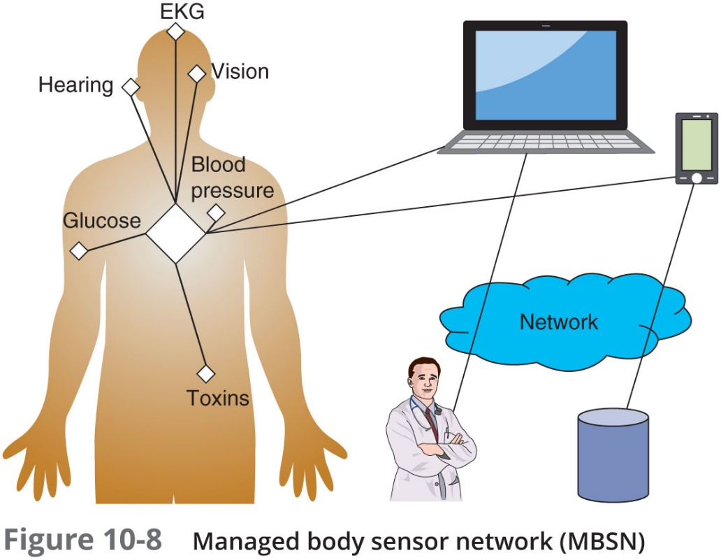
Internet of Things (2 of 3)

Slide 47
Internet of Things (3 of 3)
Autonomous body sensor network (A B S N)
Introduces actuators in addition to the sensors so immediate effects can be made on the human body
A B S N can expand the use of functional electric stimulation to restore sensation, mobility, and function to those persons with paralyzed limbs and organs

Slide 48
Security Implications
Reasons why I o T and embedded system devices are vulnerable:
Most I o T vendors are concerned with making products as inexpensive as possible, leaving out security protections
Devices that do have security capabilities implemented have notoriously weak security
Few, if any, I o T devices have been designed with the capacity for being updated to address exposed security vulnerabilities
I o T and embedded systems that can receive patches often see long gaps between the discovery of the vulnerability and a patch being applied
There are several initiatives underway to address security vulnerabilities in I o T and embedded devices

Slide 49
Review Questions
Which technology is NOT a core feature of a mobile device?
A. physical keyboard
B. small form factor
C. local non-removable data storage
D. data synchronization capabilities
What is the process of identifying the geographical location of a mobile device?
A. geotracking
B. geolocation
C. geoID
D. geomonitoring
What allows a device to be managed remotely?
A. mobile device management (MDM)
B. mobile application management (MAM)
C. mobile resource management (MRM)
D. mobile wrapper management (MWM)

Slide 50
Chapter Summary (1 of 3)
Tablet computers are portable computing devices smaller than portable computers, larger than smartphones, and focused on ease of use
Portable computers are devices that closely resemble standard desktop computer
A laptop is designed to replicate the abilities of a desktop computer with only slightly less processing power
Many mobile devices use Wi-Fi as the standard connectivity method to connect to remote networks
Many organizations have adopted an enterprise deployment model as it relates to mobile devices
B Y O D allows users to use their own personal mobile devices for business purposes

Slide 51
Chapter Summary (2 of 3)
Mobile devices can be easily lost or stolen and usually use public external networks for their Internet access
Attackers can eavesdrop on data transmissions and view services to identify the location of a person carrying a mobile device
Mobile devices have the ability to access untrusted content that other types of computing devices generally do not have
It is important to disable features and turn off those that do not support the business use of the device or that are rarely used
A lock screen prevents the mobile device from being used until the user enters the correct passcode

Slide 52
Chapter Summary (3 of 3)
Mobile device management (M D M) tools allow a device to be managed remotely
Mobile application management (M A M) consists of tools and services responsible for distributing and controlling access to apps
M D Ms can support application whitelisting, which ensures that only preapproved apps can be run on the device
An embedded system is computer hardware and software contained within a larger system that is designed for a specific function
The Internet of Things (I o T) is connecting any device to the Internet for the purpose of sending and receiving data to be acted upon

